Slide 1
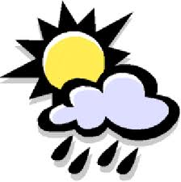
Weather Forecasting using Data Mining Techniques
Guide: M. Jagadeesh
Team:
C. Naveen(1210310414)
E.V.N.S Sangeeta(1210310419)
P. Prithvi Krishna(1210310449)

Slide 2
Data Mining and its Applications
Data mining, is the process of extracting or mining knowledge from large amount of data.
Also called Knowledge Discovery in Databases (KDD).
It can be implemented to many areas. Used for,
1.Discovery of interesting patterns
2.Clustering of data based on parameters
3.Prediction of results by using the existing data. Etc.

Slide 3
Meteorological data mining
Concerned with finding hidden patterns inside largely available meteorological data.
Weather is one of the important meteorological data.
Weather forecasting
Prediction of what the weather will be like in future.
Weather forecast involves four steps.

Slide 4
Observation
Collection of Weather data.
Classification of Weather Data
Weather Prediction
General Forecasting Model

Slide 5
Weather Forecasting comes under the classification technique of Data Mining.
Classification methods
Naïve Bayes classifier K-means clustering method.
Decision Trees
Artificial Neural Networks
Support Vector Machines
Supervised Methods
Unsupervised Methods

Slide 6
Approach:
In this work, we make use of Decision trees, implemented using ID3 algorithm for forecasting the weather.
We make use of Net Beans IDE for the complete implementation of the classification.
A User-Interface is created which allows the user to input the weather parameters we ought to classify and as well display the classified results.

Slide 7
Decision Trees :
A Decision Tree is a flow-chart-like tree structure. Each internal node denotes a test on an attribute. Each branch represents an outcome of the test. Leaf nodes represent class distribution.
In decision analysis, a decision tree can be used visually and explicitly to represent decisions and decision making.
The concept of information gain is used to decide the splitting value at an internal node.

Slide 8
The splitting value that would provide the most information gain is chosen. Formally, information gain is defined by entropy.
We have implemented Decision tree using ID3 Algorithm.

Slide 9
The data attributes considered are:
temperature, pressure, humidity and wind speed.
The data is classified into several attributes like:
haze, rain , haze and mist, rain and thunderstorm etc.

Slide 10
ID3 :
ID3 algorithm is a simple decision tree learning algorithm, developed by Ross Quinlan (1983).
The basic idea of ID3 algorithm is to build a decision tree by employing a top-down search through the given sets to test each attribute at every tree node.
The algorithm uses a greedy search, i.e., it chooses the best attribute and never reconsiders the choice already made.

Slide 11
Steps of Algorithm:
For each attribute in the database, compute its entropy.
The current node is the attribute (A) with the highest information gain.
For every value of the attribute A build a sub-tree;
If A=value 1 then generate subtree1
If A=value 2 then generate subtree2, etc.
For each sub tree, repeat this process from the first step.

Slide 12
Every time a new node is created in the tree with a variable, the attribute is removed from the variables group.
Chooses attribute that has the lowest entropy is minimum or when information gain is maximum .
The process stops when there are no attributes left.

Slide 13
Entropy and Information Gain:
Entropy is the sum of the probability of each label times the log probability of that same label.
The value for entropy is between 0 and 1 and reaches a maximum when the probabilities are all the same.

Slide 14
Select the attribute with the highest information gain
Assume there are two classes, P and N
Let the set of examples S contain p elements of class P and n elements of class N
The amount of information, needed to decide if an arbitrary example in S belongs to P or N is defined as

Slide 15
Assume that using attribute A a set S will be partitioned into sets {S₁, S₂ , …, S_{v}}
If S_{i} contains p_{i} examples of P and n_{i} examples of N, the entropy, or the expected information needed to classify objects in all sub-trees S_{i} is :
The encoding information that would be gained by branching on A

Slide 16
Net Beans:
Net Beans is an Integrated Development Environment(IDE) for developing primarily with Java, but also with other languages, in particular PHP, C/C++, and HTML5.
It was brought in by the Sun Microsystems in 1999.
The philosophy behind Net Beans is to provide an extensible IDE that provides all the tools necessary to develop desktop, enterprise, web and mobile applications.
It also serves as an application platform framework for Java desktop applications and others.
The Net Beans IDE is written in Java and can run on Windows, OS X, Linux, Solaris and other platforms supporting a compatible JVM.

Slide 17
System Model :
COLLECT DATA
Temperature
Pressure
Wind Speed
Humidity
PREPROCESS DATA SET
ESTIMATION AND PREDICTION
DATA CLASSIFICATION USING ENTROPY AND GAIN CALCULATIONS
DECISION TREE CONSTRUCTION

Slide 18
Specific Requirements:
Various requirements for this project are the daily weather observations of
Temperature
Pressure
Humidity
Wind Speed
of a particular region.

Slide 19
Class Labels obtained :
Rain
Rain, thunderstorm
Haze
Haze, mist
fog

Slide 20
UML Diagrams :
Use Case Diagram :
Collect the data
Collect the data
Pre-process the data
Pre-Process the data
Open application
Data Base
open application
enter the parameters
Enter the parameters
User
Analysis of data by
Classification of data
Using decision tree
creating SVM models
Predict the weather
Predict the weather
Maintain
Maintain
Maintain

Slide 21
Class Diagram :
User
Application
Pressure
Collect()
Generate()
pressure
Open()
Close()
Input()
Clear()
Classify()
Classify()
Database
temp
Wind speed
pressure
Wind speed
Wind speed
humidity
result
Classify()
Return_data()
Result
Haze, mist
Humidity
Temperature
fog
humidity
temp
rain
rain,thunderstorm
Classify()
Classify)
haze
Classify)

Slide 22
Sequence Diagram :
User
Application
Database
1: Collect the data
2: Returns data
3: Preprocess the data
4: Open the application
5: Enter the parameters
6: Classify the data
7: Generate reports

Slide 23
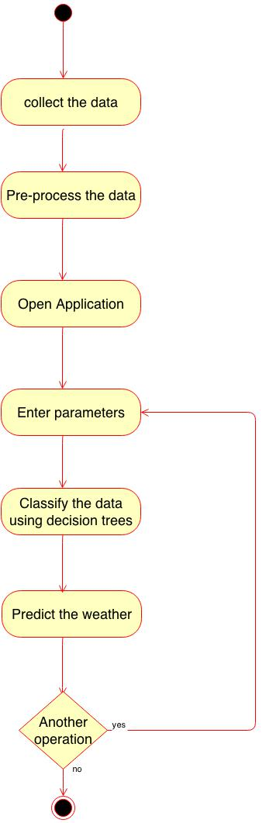
Activity Diagram :

Slide 24
Conclusion and Future scope:
The working of this application is largely dependent on the daily estimates of weather and changes dynamically from time to time and season to season. This application is limited to only few places. It can be further developed by making more exhaustive analysis of the weather. The appearance and the user interface can be further enhanced.

Slide 25

THANK YOU.

